Slide 1
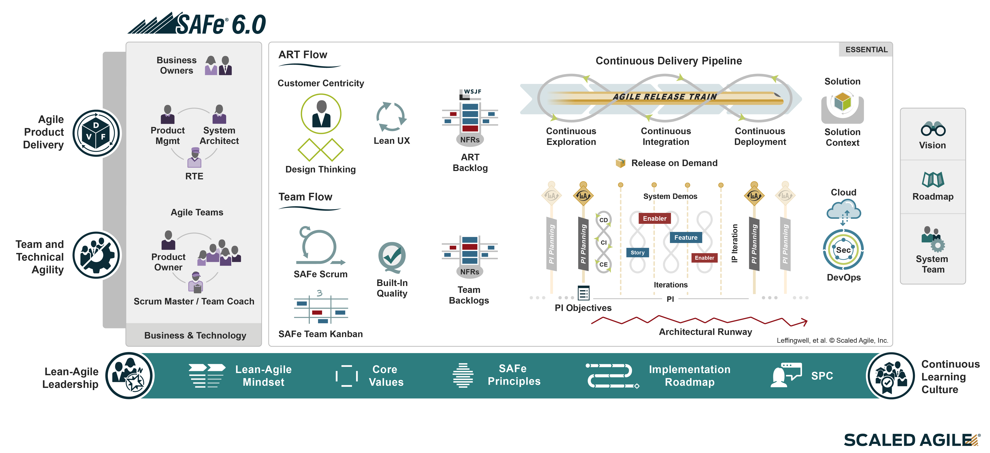
Essential SAFe®

